Slide 1
WissKI Virtual Research Environment and Linked Open Data Management System
Robert Nasarek
Germanic National Museum
r.nasarek@gnm.de
https://fedihum.org/@rnsrk

Slide 2
HANDS ON WISSKI
Get your own instance: https://wisski.cloud
Use pre-existing: https://<instance>.wisski.cloud
ddd24-1, ddd24-2 … ddd24-10
Git with Info:
https://github.com/rnsrk/ddd24-wisski-workshop

Slide 3







What is WissKI?
Wissenschaftliche KommunikationsInfrastruktur – Scientific Communication Infrastructure)
Virtual research environment for semantical data management
15 years development
Part of Drupal framework
30 institutional partners
Middleware between Drupal CMS, ontology and triple store
Completely free and open
Notes:
[0] WissKI is a virtual research environment for semantical data management.
[1] It‘s part of the Drupal framework, which is particularly suitable for complex page structures with high demands on adaptabilty and security. About 2% of all websites run with Drupal, which is about 1,000,000 websites, including the Federal Environment Agency (Umweltbundesamt) or Greenpeace. The user community comprises 1,100,000 registered users with 36,000 developers.
[2] WissKI in particular is a kind of middleware that negotiates between the Drupal content management system, an ontology and a triple store.
[3] It has been developed and funded for 15 years, including 5 years of direct funding from the DFG and 6 months from the NFDI. In the meantime, the further development is also community-based within dozens of other projects, such as Objekte im Netz (FAU), Semantics4ArtsAndArchitecture (UB Heidelberg), Kunstsammlung Böhler (ZIKG), or Objektsprache und Ästhetik (Leopoldina).
[4] In total, WissKI delivers hundreds of research environments for 30 institutional partners,
[5] Is and stay open and free.

Slide 4













Challenges of (humanities) research data
Plan
Reuse
Collect
Time limited projects
Rotating stuff
Archive
Analyse
Hermeneutic data acquisition
Publish
Implicite Knowledge
but global context
Notes:
The challenges of humanties research data arises from several circumstances.
[1] The normal project runtime is 3 years, after that there is nobody in a paid position to take care of the data and dissemination.
[2] Even if there a following projects, the stuff is changing, and take their wisdom with them.
[3] The data is often collected from historical and (widersprüchlichen, mehrdeutigen und uneinheitlichen) sources.
[4] Every research projects needs to answer project driven specific questions, but add meaningful context to their data.

Slide 5

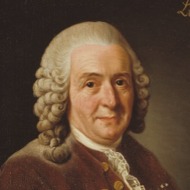



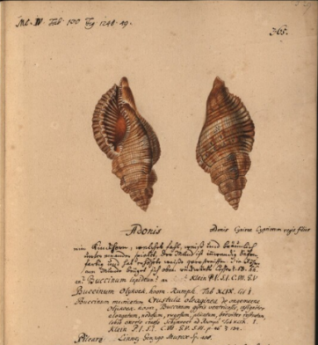


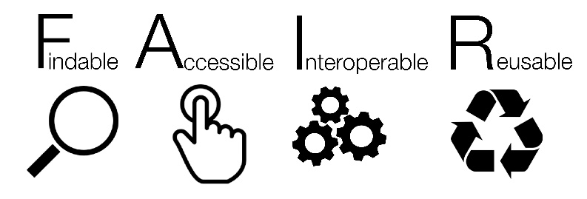

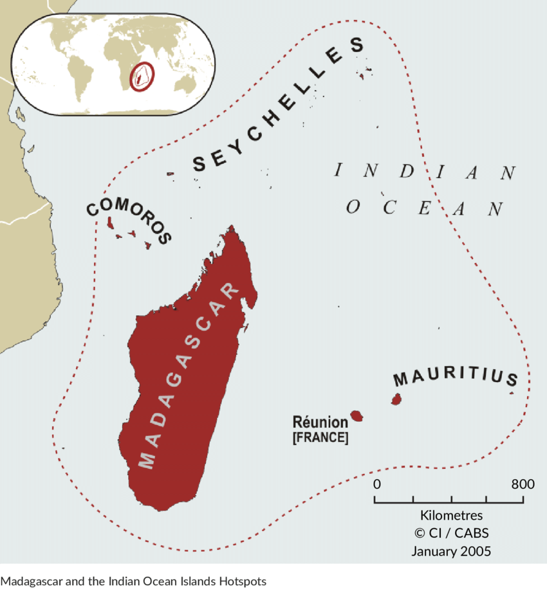



Linked Open Data
https://barcamp.wisski.cloud/contents/118573349
Referencable
Distinguishable & assignable
TurboGrafx16
SPARQL, REST…
Standardised
Manufacturer | NEC (Japan)
Lifetime
Components | CPU: Memory: 8Bit RAM Grafics: Sound:
Accessible & retrievable
Notes:
0) The principle of LOD is simple. Imagine you are looking for information about the artist Lucy Sparrow.
One database has information about her biography,
another one about her art objects
and a third one about her exhibitions.
Linked Open Data means that these three repositories are linked together and can be used as if from one database.
4) The data need four properties for this:
They must be referenced, preferably by a URI, but at least by an ID.
5) They must be disambiguated, meaning they really talk about the same thing.
6) They must be standardized so that they can be merged.
7) And they must be openly accessible, so that they can be accessed at any time.
8) This may sound familiar, because this is in short what the FAIR-Principles are about.

Slide 6
Relational Data Models
?
?
Manufacturer
Name | Place
NEC | Japan
ATARI | USA
Notes:
Relational models are straight forward and intuitiv, but lack in the documentations of the relations.
[1] The relation between the Entity „Person“ and the Property „Name“ is implicite.
[2] And beside the fact, that „Birthdate“ and „Occupation“ are in the same table, you do not know which semantics connects them.

Slide 7
Ressource Description Framework
wisski:w4556899
rdfs:type
ecrm:E39_Actor
wisski:w4556899
crm:P1_is_identified_by
wisski:482843j905
wisski:482843j905
ecrm:P1i_identifies
wisski:w4556899
wisski:482843j905
rdfs:type
crm:E42_Appellation
wisski:482843j905
crm:P3_has_note
NEC
Class
Object Property
Literal
Instance
Data Property
Notes:
The Ressource Description Framework (RDF) and its extensions (RDFS) and the Web Ontology Language (OWL) offers a way to model semantic structures.
[1] There are classes in a sense of concepts of things (Like Persons or Appellations).
[2] Instances of classes – the individuals like you and me.
[3] Object properties – The attributes a Class (and therefore its instances), could or must have, which points to other classes/ instances as objects.
[4] Datatype properties – Which connects the data values, like strings, integers etc.
[5] And there are a lot of constraints or attributes each class or property could have, like to be bound to an inverse or cardinality or so on.
We are not going to deep to ontology engineering, but you can define fancy things like if something has a name and a birthdate, birthplace, an occupation and an social insurance number it is a person. And if an instance of someting has those attributes it should automatically become the class person. This is called reasoning and helps to identify missing parts of aircrafts, [Geldwäsche) and the recommendations in online shops.
If you look closely you the, that the concepts are namespaced – The interesting namespace here is crm, because it comes from the CIDOC-CRM.

Slide 8
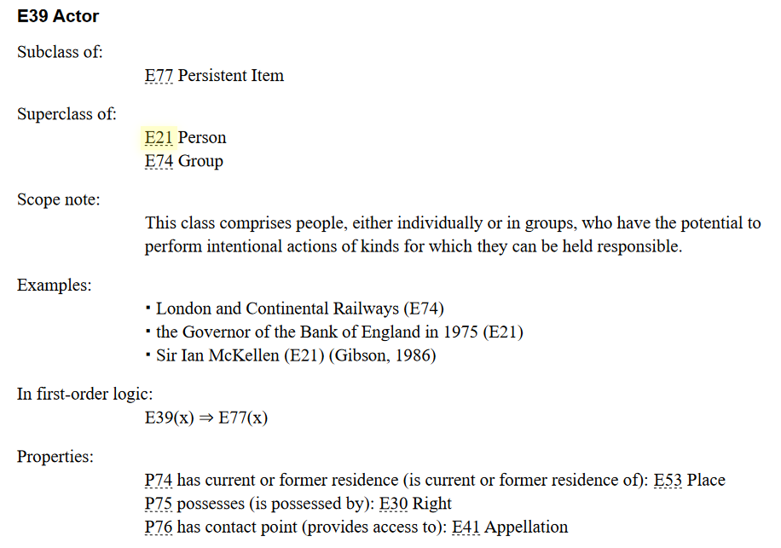
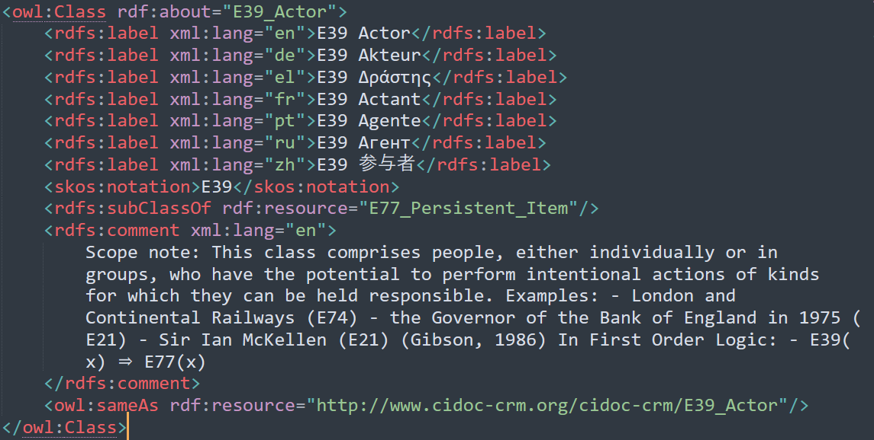
CIDOC-CRM
https://cidoc-crm.com
OWL Implementation: https://erlangen-crm.de
Notes:
CIDOC-CRM the Conceptual Reference Model of the International Comitee for Museal Documentation is developed to provide a starting point if you like to model collections or events and devently worth a visit. It contains the most necessary concepts and have a OWL-Implementation at https://erlangen-crm.de.

Slide 9
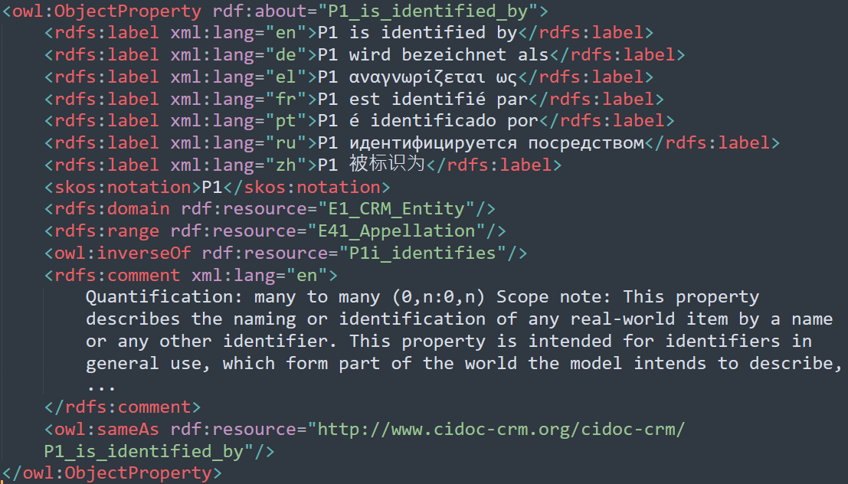
CIDOC-CRM

Slide 10
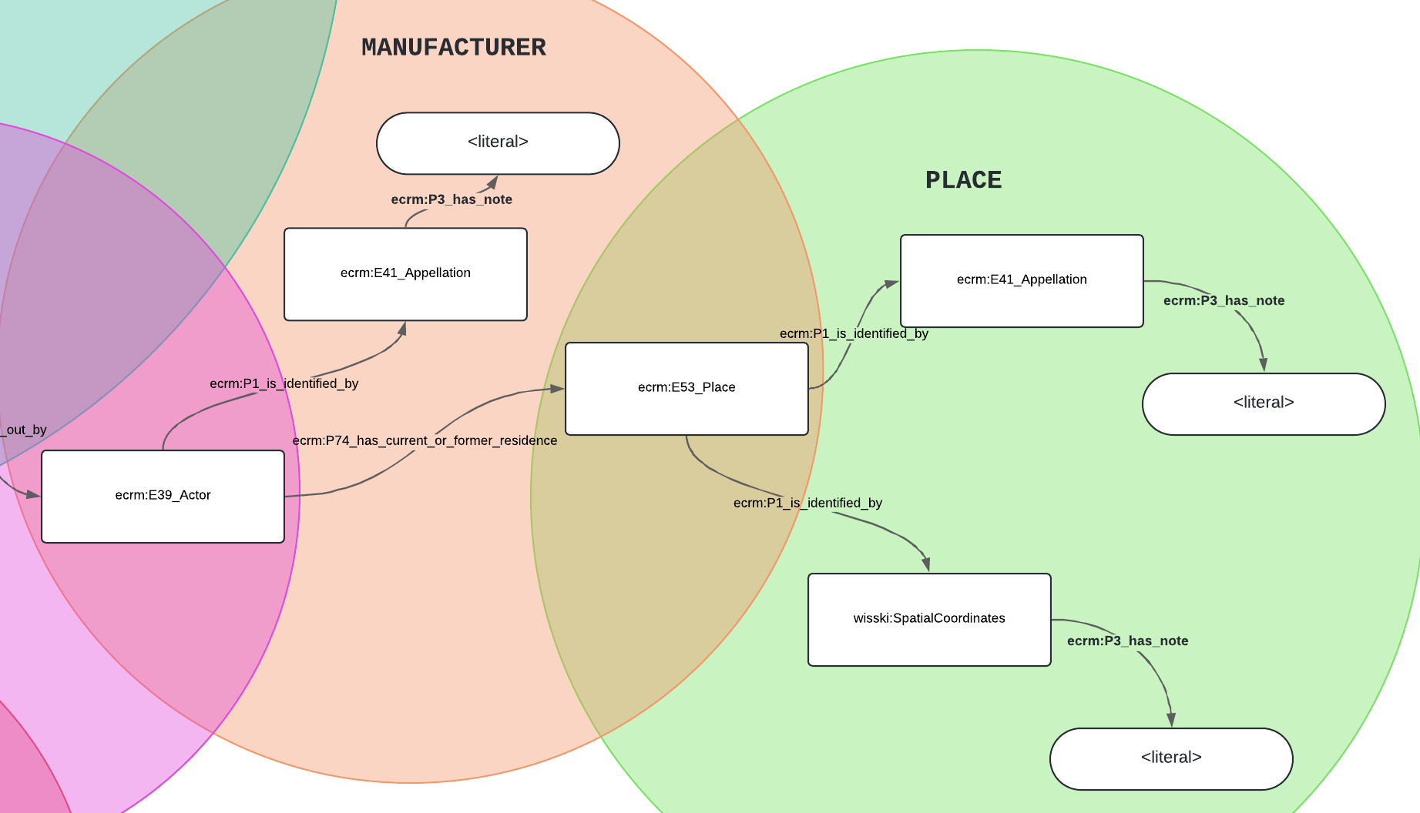

Slide 11




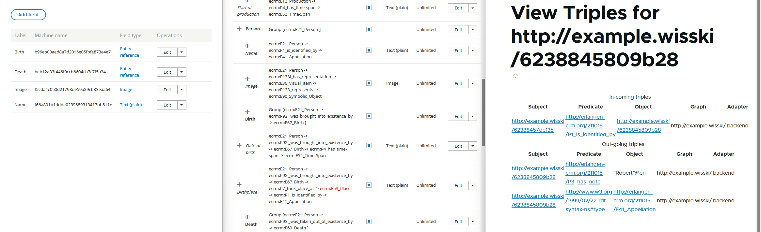
WissKI
Middleware
Is a

Slide 12
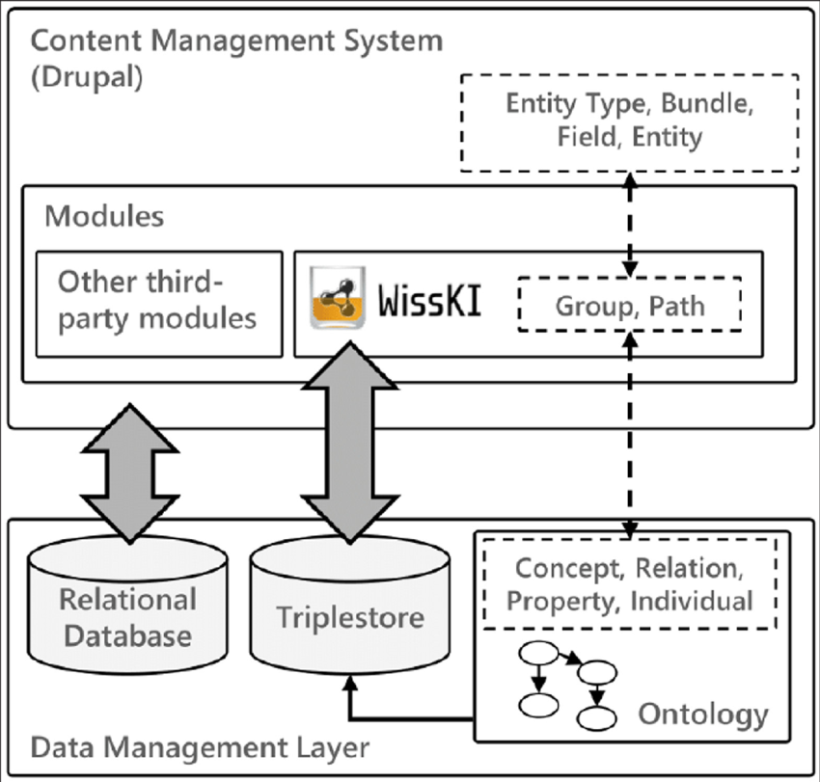
Data and Infrastructure

Slide 13
HANDS ON WISSKI
Get your own instance: https://wisski.cloud
Use pre-existing: https://<instance>.wisski.cloud
ddd24-1, ddd24-2 … ddd24-10
Git with Info:
https://github.com/rnsrk/ddd24-wisski-workshop

